Slide 1

Introduction to cyber Security

Slide 2
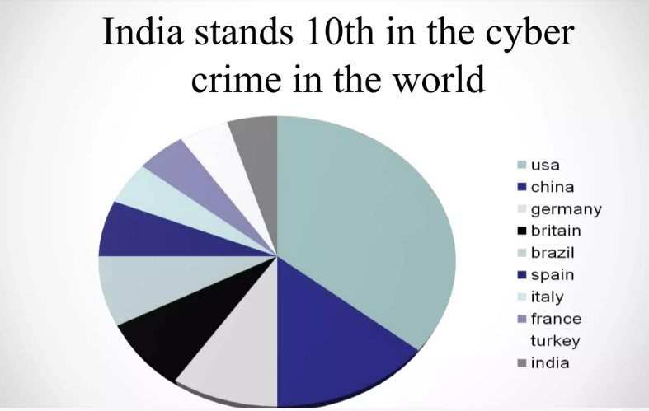
Topics covered….
Introduction to Information Security and its policies:
CIA Triad-3 pillars of information security architecture,
CIA components and its importance,
Cyber security threats and best practices,
Access controls and its types,
Discretionary access control,
Mandatory access control,
Role based access control,
Arbitrary based access control ,
Active Reconnaissance, Types of Reconnaissance,
Passive Reconnaissance,
Types of Cyber Attack,
Vulnerability Assessment and its features,
Concept and types of Scanning Methodology, Penetration Tests

Slide 3
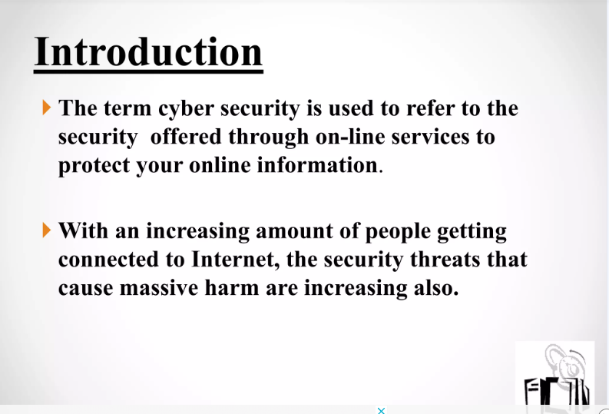
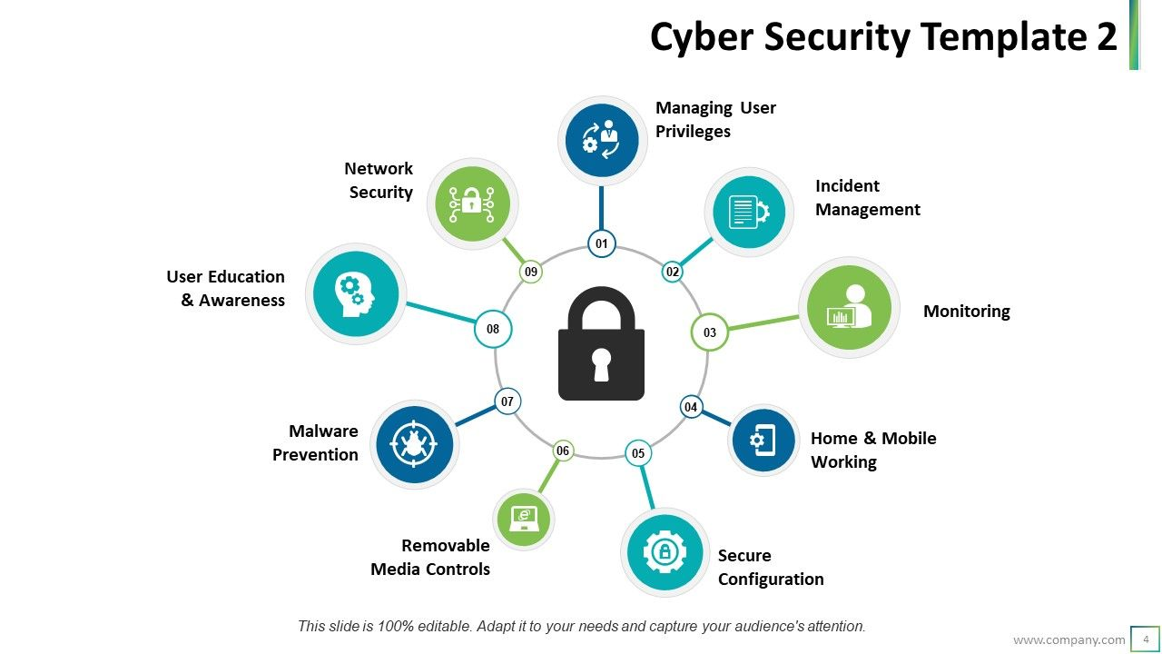

Slide 4
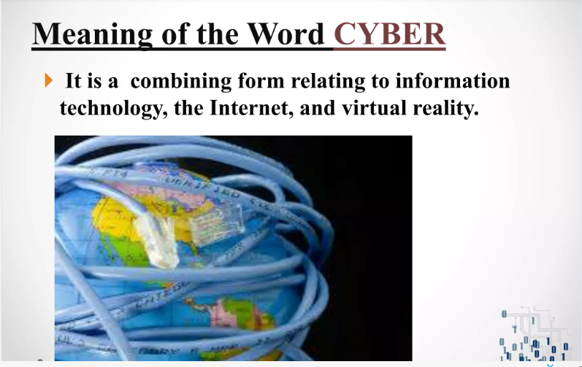

Slide 5
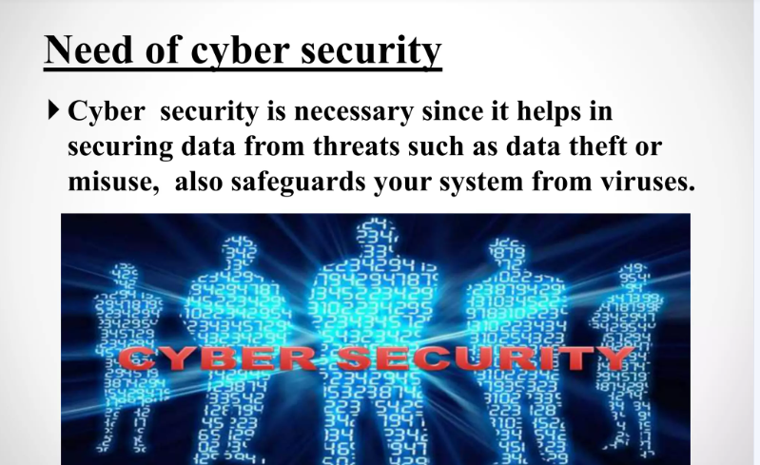

Slide 6
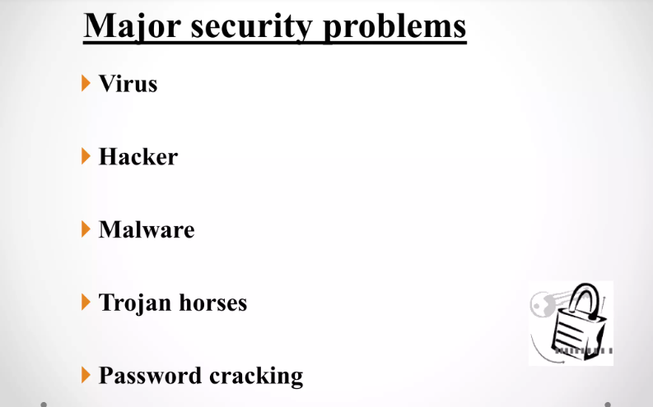

Slide 7
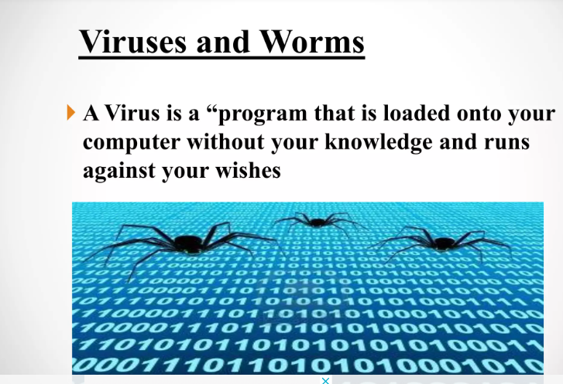
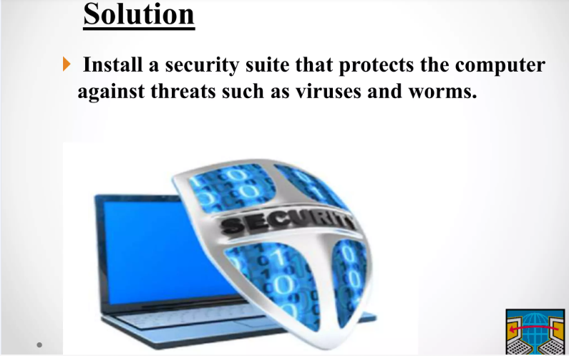
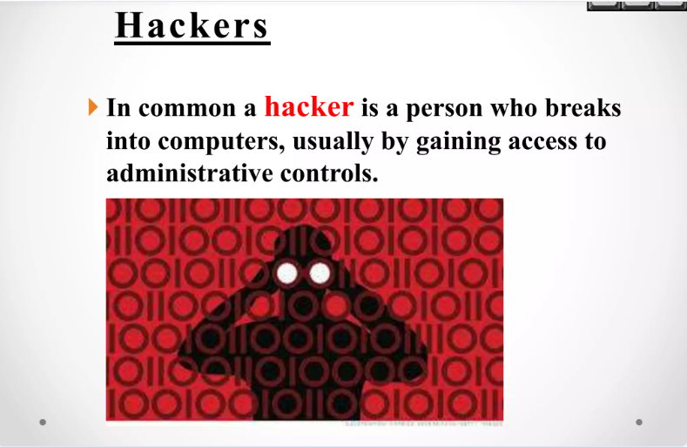
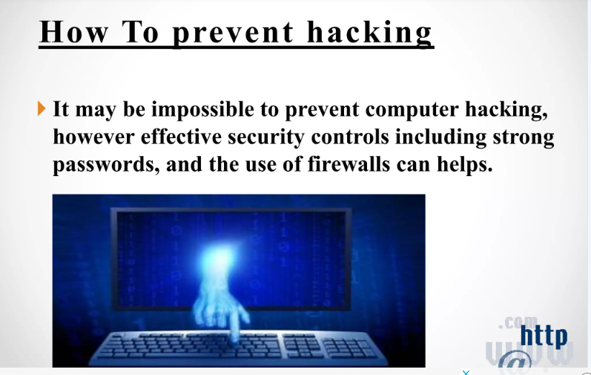

Slide 8
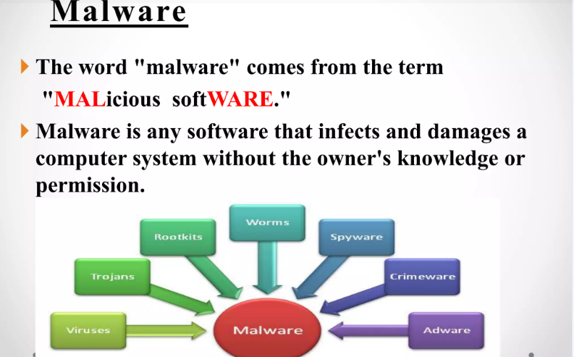
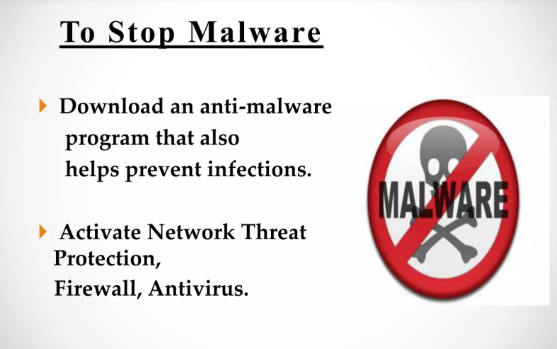
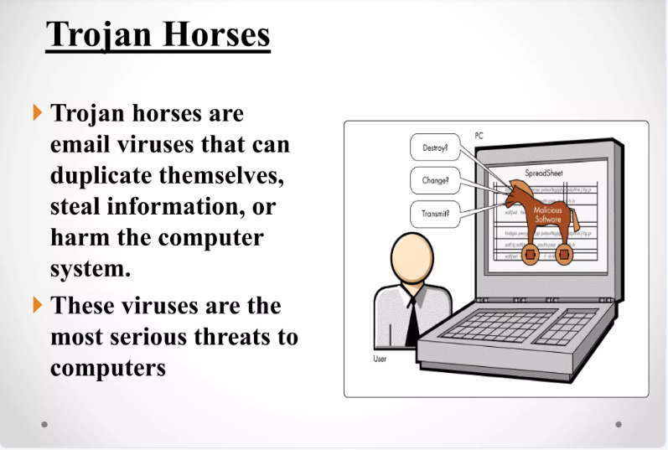
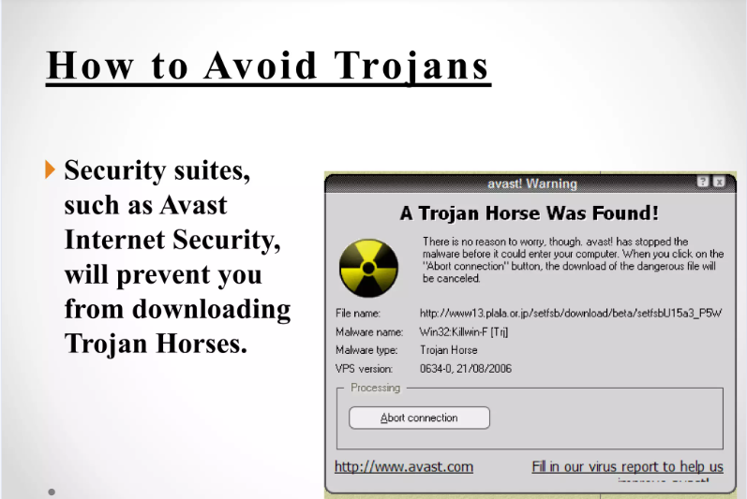

Slide 9
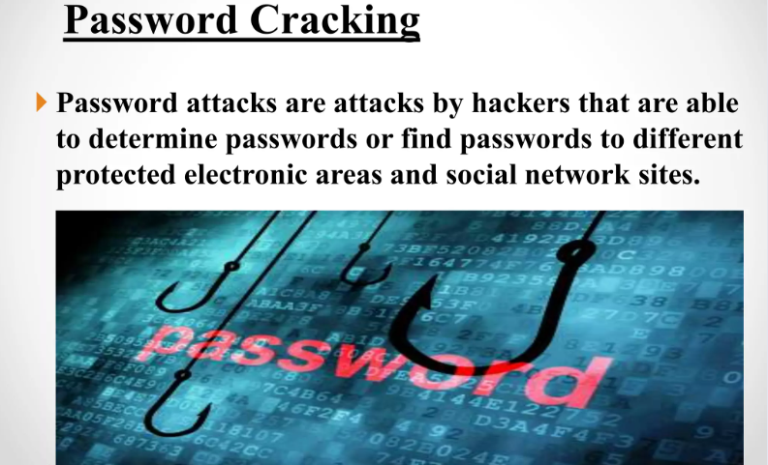
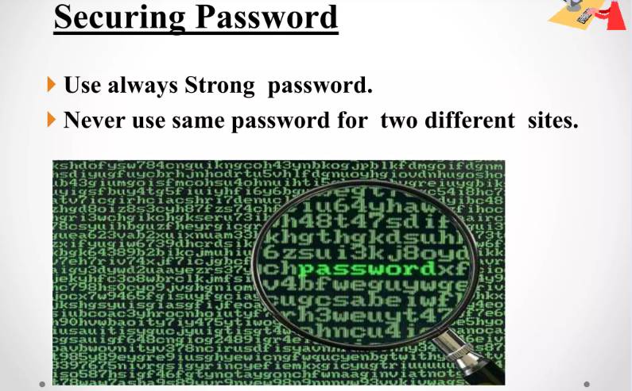


Slide 10

Introduction to Cyber Security
In today's digital world, cyber security is crucial for protecting sensitive information. This presentation will explore the CIA Triad—Conﬁdentiality, Integrity, and Availability—and its vital role information security architecture.

Slide 11

What is the CIA Triad?
The CIA Triad is a foundational model in information security that guides policies for data protect. It consists of three core principles: Conﬁdentiality, Integrity, and Availability, each essential for ensuring a secure environment.

Slide 12


Conﬁdentiality E plained
Conﬁdentiality ensures that sensitive information is accessed only by authorized users. It involve measures like encryption, access controls, and authentication to protect data from unauthorized access.

Slide 13

Integrity in Cyber Security
Integrity refers to the accuracy and reliability of data. It ensures that information is not altered or tampered with during storage or transmission, using techniques like hashing and
checksums.

Slide 14

Understanding Availability
Availability ensures that information and resources are accessible when needed. This involves maintaining systems and networks to prevent downtime and using redundancy and backups to protect against failures.

Slide 15

The Interconnection of CIA
The principles of the CIA Triad are interconnected; compromising one can affect the others. For example, if conﬁdentiality is breached, it may lead to a loss of integrity and availability.

Slide 16

Role in Information Security Architecture
The CIA Triad is integral to designing an effective information security architecture. It helps organizations assess risks and implement controls that align with their security objectives and compliance requirements.

Slide 17
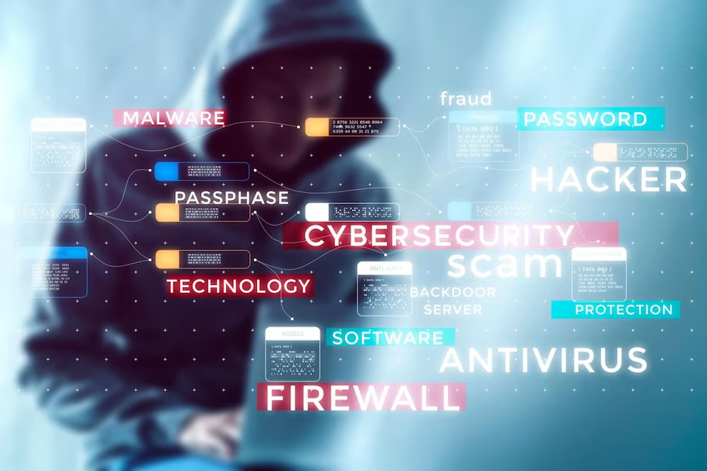
Threats to the CIA Triad
Various threats can jeopardize the CIA Triad. These include malware, phishing, and insider attacks. Understanding these threats is essential for developing effective security strategies and defenses.

Slide 18

Best Practices for CIA Implementation
To effectively implement the CIA Triad, organizations should adopt best practices such as regular security audits, employee training, and robust incident response plans to mitigate potential risks.

Slide 19

Case Studies in Cyber Security
Examining real-world case studies highlights the importance of the CIA Triad. Successful organizations prioritize these principles to safeguard their data and maintain customer trust.

Slide 20

Future of Cyber Security
As technology evolves, so do the challenges in cyber security. The CIA Triad will continue to be a guiding framework, adapting to new threats and innovations in information security
architecture.

Slide 21

What is Access Control?
Access control refers to the methods and policies that restrict access to resources in a computing environment. It ensures that only authorized users can view or modify data. Understanding its importance is crucial to maintaining a secure system against potential threats.

Slide 22

Types of Access Control
There are several types of access control, including discretionary access control (DAC), mandatory access control (MAC), and role-based access control (RBAC). Each type has its unique features and is suited for different organizational needs and
security requirements.

Slide 23

Discretionary Access Control (DAC)
In DAC, owners of resources have the discretion to make decisions about who can access their resources. This ﬂexibility can lead to vulnerabilities if not managed properly, as it relies heavily on users' judgment and compliance with security policies.

Slide 24

Mandatory Access Control
(MAC)
MAC enforces strict policies determined by a central authority. Users cannot change access ermissions, which enhances security but can reduce ﬂexibility. This approach is often used in environments where data conﬁdentiality is paramount, such
as government systems.

Slide 25

Role-Based Access Control (RBAC)
In RBAC, access rights are assigned based on user roles within an organization. This method simpliﬁes management and enhances security by ensuring users only have access to information necessary for their job functions, minimizing the risk of data breaches.

Slide 26

Best Practices for Access Control
Implementing best practices for access control includes regularly reviewing permissions, using multi-factor authentication, and training employees on security awareness. These practices help mitigate risks and strengthen the overall security posture of an organization against cyber threats.

Slide 27

Understanding Reconnaissance
is the initial phase of cybersecurity assessments. It involves gathering information about a target system to identify potential vulnerabilities. This step is critical as it lays the groundwork for more in-depth
testing and analysis.

Slide 28

Types of Reconnaissance
There are two main types of
.
reconnaissance: Active and Passive reconnaissance involves gathering information without direct interaction, while active reconnaissance includes direct engagement with the target system to collect data. Each method has its advantages and risks.

Slide 29
Types of Cyber Attacks:
Ransomware is a type of malware that prevents users from accessing their files, systems, or networks, and demands payment to regain access. Ransomware attacks can be costly and disruptive, and can lead to loss of critical data
A botnet attack is a cyberattack that uses a botnet, a network of infected devices, to carry out a variety of malicious actions
Social engineering is the term used for a broad range of malicious activities accomplished through human interactions. It uses psychological manipulation to trick users into making security mistakes or giving away sensitive information.
Cryptohijacking is the unauthorized use of a computer or device's processing power to mine cryptocurrencies, often without the owner's consent or knowledge.
Phishing attacks are a form of social engineering, and are often carried out by impersonating a trustworthy entity in an electronic communication

Slide 30

Importance of Vulnerability Assessment
A is essential
for identifying security weaknesses in systems. It involves scanning and analyzing systems to ﬁnd ﬂaws that could be exploited by attackers.
Regular assessments help organizations prioritize remediation efforts effectively.

Slide 31




Vulnerability Assessment
Tools
Various tools are available for conducting vulnerability assessments, such as , , and . These tools automate the scanning process and provide detailed reports, enabling teams to address vulnerabilities efﬁciently.

Slide 32

What is Penetration Testing?
Penetration Testing simulates real-world attacks to evaluate the security of systems. This proactive approach helps organizations understand their security posture and identify weaknesses that could be exploited by malicious actors.

Slide 33






Phases of Penetration Testing
Penetration testing typically involves several phases: , ,
, ,
and . Each phase is vital to ensure a thorough assessment of security measures and the effectiveness of defenses.

Slide 34


Beneﬁts of Penetration Testing
Conducting regular provides numerous beneﬁts, including identifying critical vulnerabilities, enhancing incident response strategies, and ensuring compliance with industry regulations. These tests are essential for a robust cybersecurity framework.

Slide 35





Integrating Cybersecurity Practices
To effectively protect against cyber threats, organizations must integrate
,
, and
into their security strategies. This holistic approach ensures comprehensive coverage and proactive defense mechanisms.

Slide 36


Challenges in Cybersecurity
Despite advancements, cybersecurity faces signiﬁcant challenges, including
, ,
and the need for continuous training. Organizations must stay vigilant and adapt their strategies to counter these ongoing challenges.

Slide 37


Future of Cybersecurity
The future of cybersecurity will likely involve increased use of and
to enhance threat
detection and response. Organizations must be prepared to adopt new technologies and methodologies to stay ahead of cybercriminals.

